Slide 1

RAJIV GANDHI UNIVERSITY OF KNOWLEDGE AND TECHNOLOGIES
SRIKAKULAM
DEPARTMENT OF ELECTRONICS AND COMMUNICATION
ENGINEERING
MINI PROJECT - 1 BATCH-25
RADAR DETECTION SYSTEM USING ARDUINO
Project Members:
Project Guide:
Mrs. K Vasundhara _{M. Tech}
A. K. V. Sudheer | (S191057)
P. Vijaya Kranthi | (S190743)
K. Satya Madhava | (S190572)
N. B. S. Rama Lakshmi | (S190498)
A. Vijaya Babu | (S180398)
B. Veerendra | (S190824)

Slide 2
Table of Contents:
Abstract
Literature Survey
Materials Required
Ultrasonic Sensor
Servo Motor
Software Used
Circuit Diagram
Schematic Diagram
Block Diagram
Working
Output
Advantages
Disadvantages
Real time Applications
References

Slide 3
Abstract:
Radar technology plays a pivotal role in a wide range of applications, including aviation, meteorology, defence, and traffic management. In this context, our project focuses on the development of a Radar Detector system using Arduino and utilizes Processing4 software for signal visualization. As electronics and communication students, our goal is to create a cost-effective yet efficient radar detection system that can be used for educational and demonstrative purposes.
The primary objective of this project is to design, build, and program a radar detector that can effectively detect the presence and distance of objects in its vicinity. We utilize an Arduino microcontroller to control the radar system, taking advantage of its versatility and ease of programming. The radar detector employs ultrasonic or microwave sensors to transmit and receive signals, enabling it to calculate the distance to an object accurately.
key components: Arduino Microcontroller, Ultrasonic Micro Sensors, Processing4 Software.
S

Slide 4
Literature Survey:
Our project is like a smart radar that uses simple tools like Arduino Uno, a servo motor, and an ultrasonic sensor. It looks around in a wide area of 180 degrees. Unlike some other projects, ours isn't just about being cheap; it's also about being really useful. We made it special by putting the sensor on a moving part so it can keep an eye on a bigger area, making it good for lots of different things.
While some projects use fancy and expensive technologies, ours keeps things simple and doesn't cost a lot. This is important, especially when we need to be careful with our money. Many similar projects use radar detectors for different jobs, but what makes ours stand out is that it's not just cheap; it also visualizes the information received by the ultrasonic sensor. i.e., the position and distance of an object.
In the end, our radar project is a great choice compared to others. It's not just about saving money; it's also about doing a better job.

Slide 5
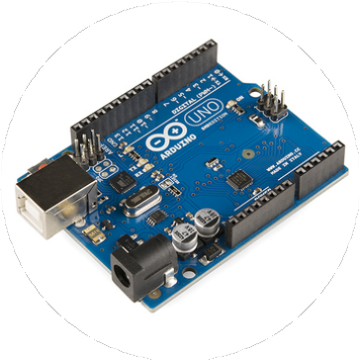
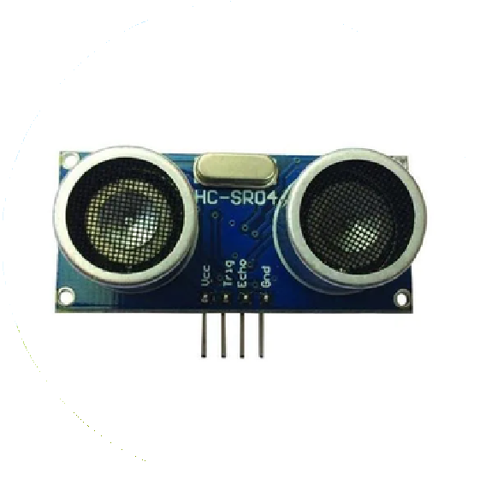
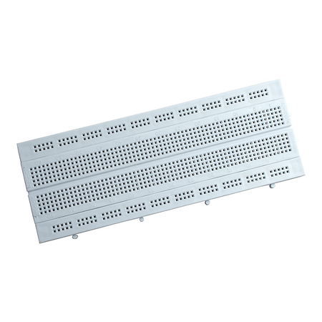
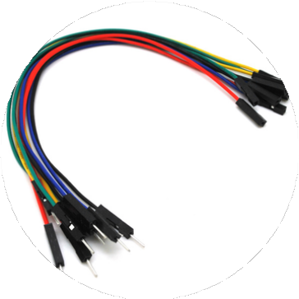
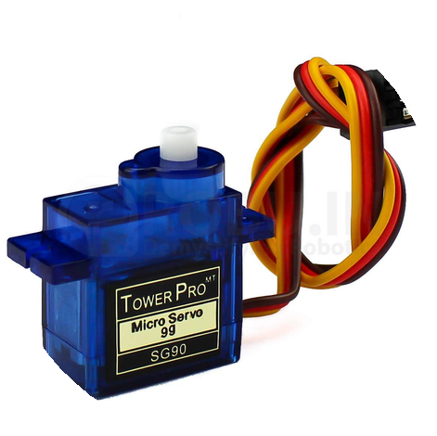
Materials Required
Arduino Uno
Ultrasonic sensor HC-SR04
BreadBoard, Jump wires
Micro Servo

Slide 6
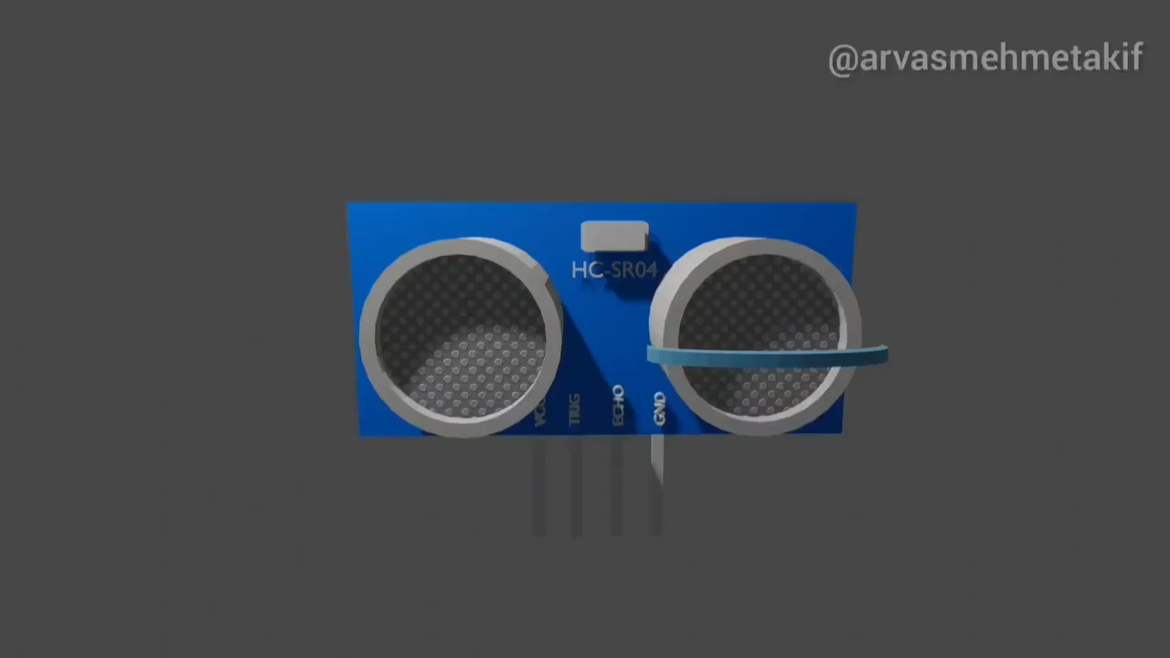
Ultrasonic Sensor:

Slide 7
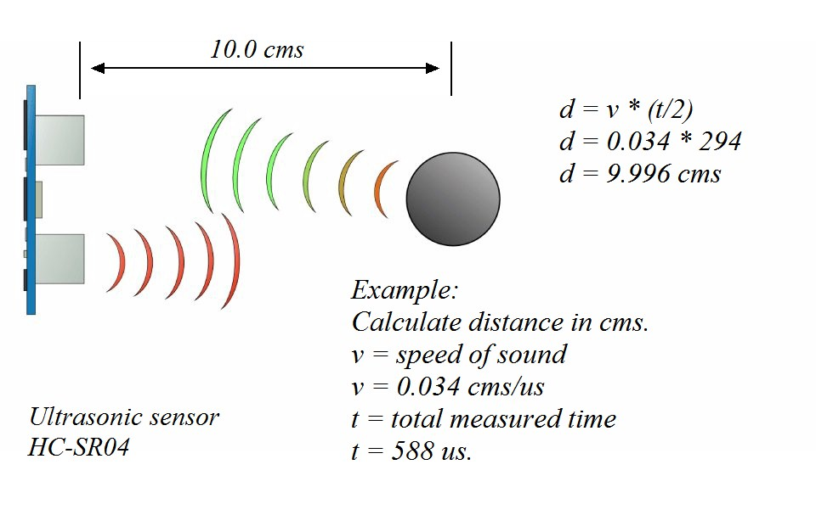
Example:

Slide 8
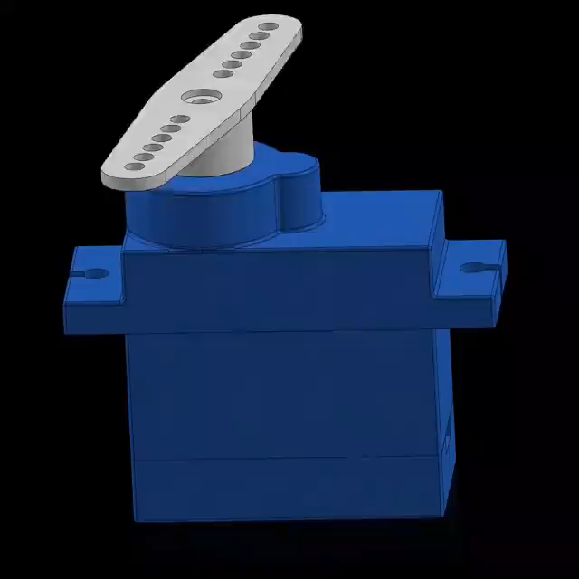
Servo Motor:

Slide 9



Software Used:
Arduino IDE
Processing 3

Slide 10
Block Diagram:
ARDUINO UNO R3
Ultrasonic
Sensor
Trig
Processing Software
Object
Echo
Servo motor

Slide 11
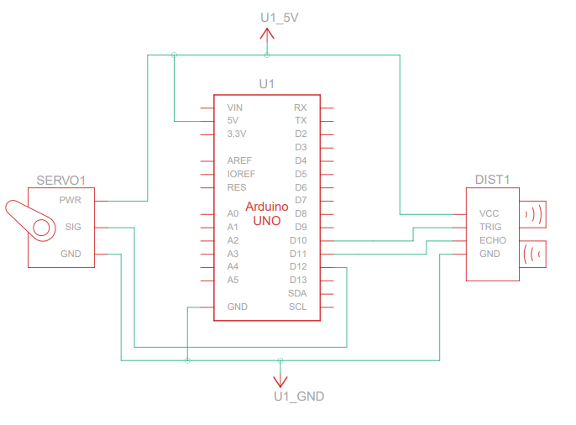
Schematic Diagram:

Slide 12
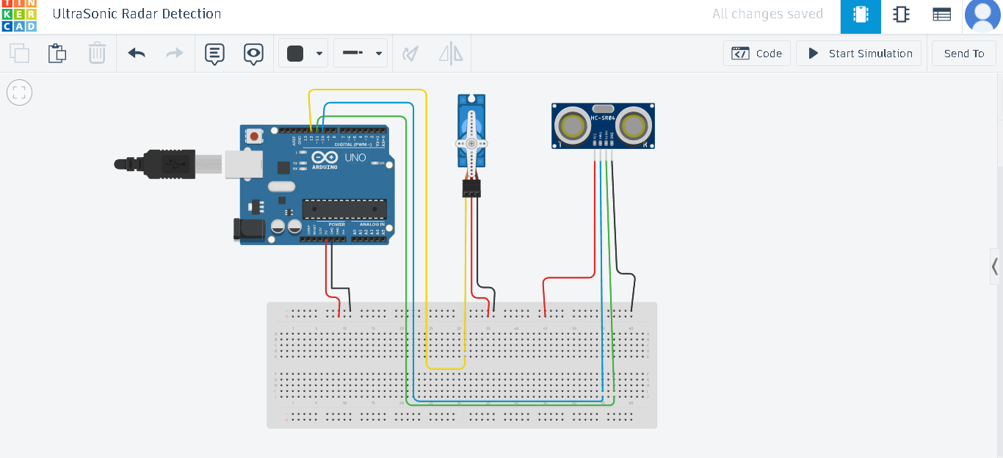
Circuit connections:

Slide 13
Working:
After Connecting the Circuit as shown in Circuit diagram, We have to dump the code into Arduino using Arduino IDE.
After Dumping the code into Arduino Board, The Servo Motor rotates along with the Ultrasonic Sensor. The Ultrasonic Sensor gives data to the Serial Monitor.
The Processing Software takes input from the Serial Monitor and Visualize the result in the designed Radar graph.

Slide 14
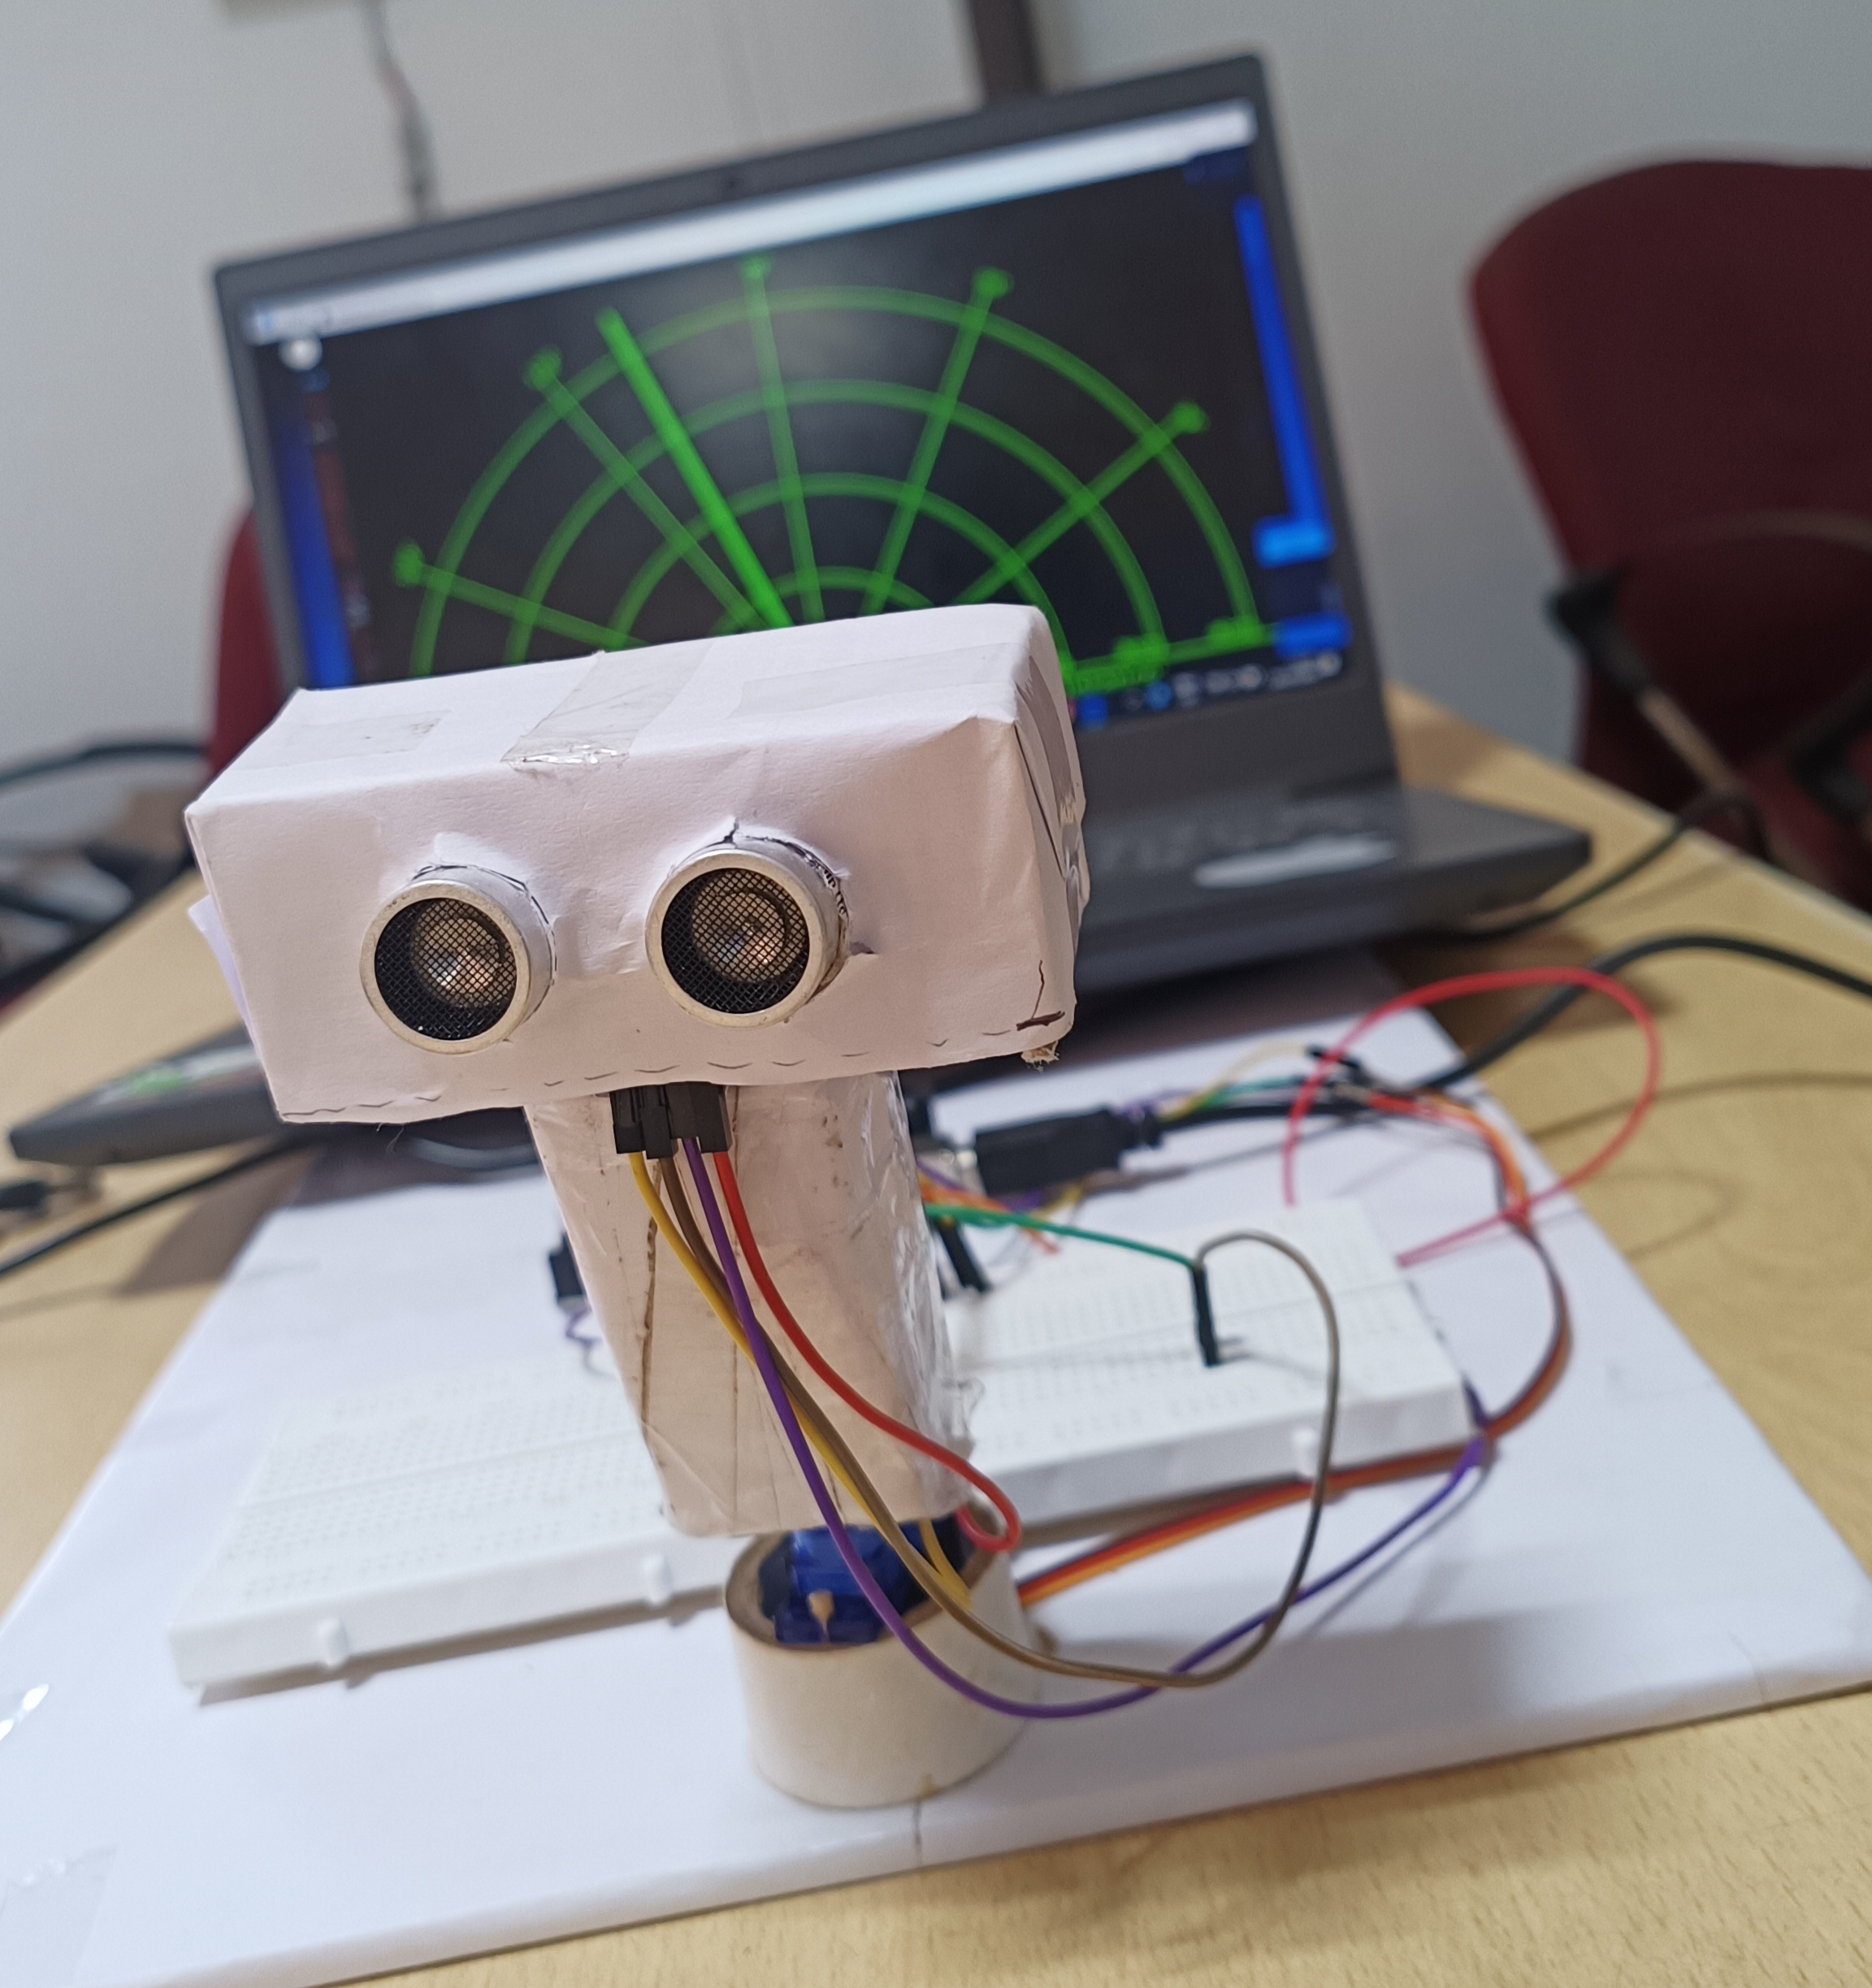
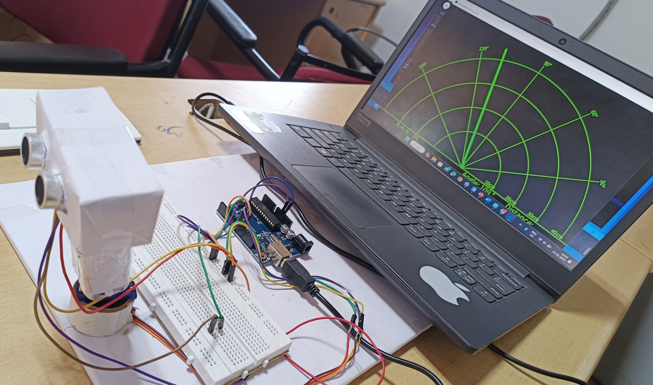
Output:

Slide 15
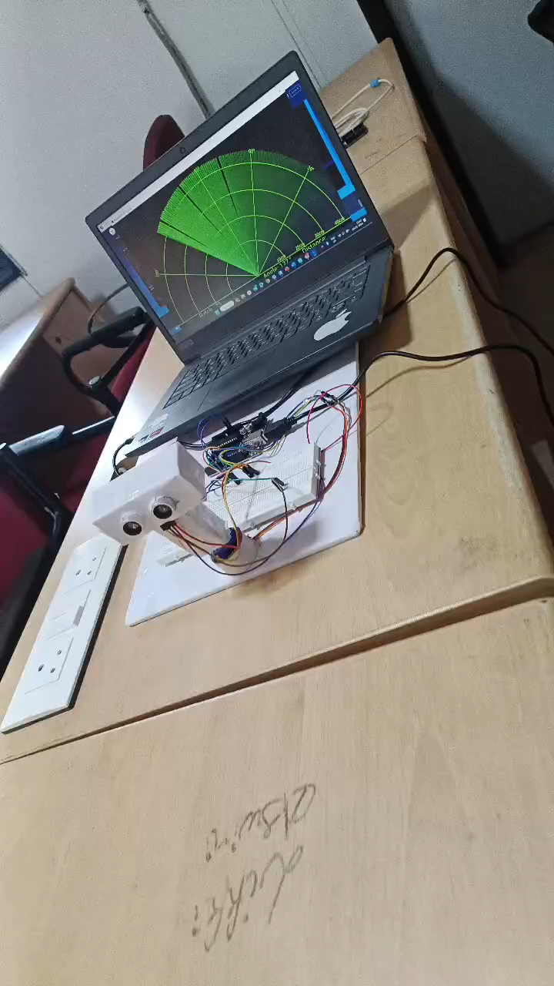
Sample Video:

Slide 16
Advantages:
Works in adverse weather conditions
Precise location and distance calculation
Versatility

Slide 17
Disadvantages:
This Ultrasonic Radar takes more time to lock on an object. Since radio signals travel freely in air and space, it takes more time to get to the object and back.
Large objects that are close to the Transmitter can saturate the receiver. The radio signals work best when the object is further away from the receiver and not closer.

Slide 18
Applications:
Airforce
Marine
Ground Traffic Control
Enemy Detector
Home Intrusion detection system

Slide 19
References:
https://3ciencias.com/wp-content/uploads/2019/01/Art_14-1.pdf
https://mytectutor.com/simple-ultrasonic-radar-system-using-arduino/
https://www.semanticscholar.org/paper/Range-Detection-based-on-Ultrasonic-Principle-Thomas-JithinK/7598c800d6ab21e8ad8dcefbf0d39b4b20e40777#related-papers

Slide 20
Thank You

